Slide 1
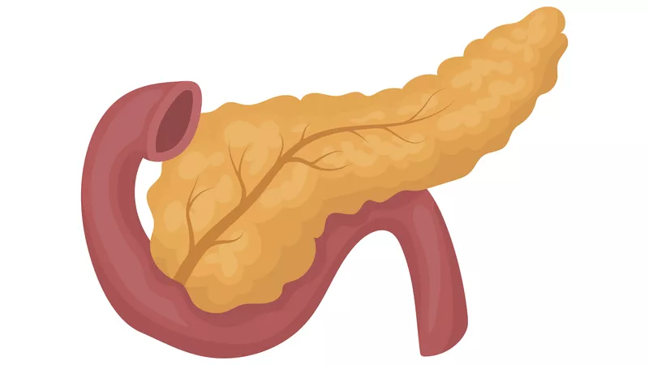










Severe Acute Malnutrition
SAMPA
Role of the Pancreas

